Slide 1
Employee Data Analysis using Excel
STUDENT NAME:JOSHUA A
REGISTER NO:312214517/01B676FB603B58E972A47E47B34881DF
DEPARTMENT:B.COM COMPUTER APPLICATION
COLLEGE:ST.THOMAS COLLEGE OF ARTS & SCIENCE

Slide 2
PROJECT TITLE
USING PIVOT TABLES FOR EMPLOYEE TURNOVER ANALYSIS

Slide 3


AGENDA
Problem Statement
Project Overview
End Users
Our Solution and Proposition
Dataset Description
Modelling Approach
Results and Discussion
Conclusion
3/21/2024 Annual Review

Slide 4

PROBLEM STATEMENT
*The Human Resources department is experiencing challenges in understanding and managing employee turnover within the organization.
Current methods of data analysis are insufficient in identifying key trends and patterns related to turnover, such as which departments, job roles, or demographic groups are most affected.
*This lack of insight hampers the ability to develop targeted retention strategies.

Slide 5

PROJECT OVERVIEW
*Employee turnover is a critical issue for organizations, affecting productivity, morale, and financial performance.
*Understanding the factors contributing to turnover is essential for developing effective retention strategies.
*This project aims to leverage pivot tables to analyze employee turnover data, providing insights into patterns and trends that can inform decision-making within the Human Resources (HR) department.
.

Slide 6

WHO ARE THE END USERS?
Human Resources (HR) Team:
• HR Analysts: Responsible for conducting the analysis and presenting the findings.
• HR Managers: Interested in understanding the turnover trends to implement strategic initiatives.
2. HR Directors and Executives:
• HR Directors: Oversee the overall HR strategy and need the insights to align turnover management with organizational goals.
• Chief HR Officer (CHRO): Utilizes the data to guide company-wide HR policies and strategies.
3. Department Heads and Managers:
• Managers: Need to understand turnover trends within their teams to address specific issues and improve retention.
•Department Heads: Use the analysis to make decisions related to staffing, training, and employee engagement.
4.Executives and Senior Management:
• CEO/CFO: Interested in the financial

Slide 7

OUR SOLUTION AND ITS VALUE PROPOSITION
1. Streamlined Data Organization
2. Dynamic Analysis Capabilities easy filtering and sorting of data
3. Real-Time Insights and Reporting
4. Cost-Effective Solutionavailable tools

Slide 8
Dataset Description
*Employee= KAGGLE
*26-Features
*9-Features
*Emp id- Number
*Name Text
*Emp- Type
*Current Employee Rating- Number
*Gender- Male female
*Employee Rating-Number

Slide 9

THE "WOW" IN OUR SOLUTION
.=IFS(Z8>=5,”VERY HIGH”,Z8>=4,”HIGH”,Z8>=3,”MED”,TRUE,”LOW”)
3/21/2024 Annual Review
9

Slide 10
MODELLING
*Employee Details: Employee ID, name, department, job title, etc.
*Employment Dates: Start date, end date (if applicable).
*Reasons for Leaving: If they have left, the reason (e.g., resignation, retirement, termination).
*Tenure: The length of time the employee has been with the organization
10

Slide 11
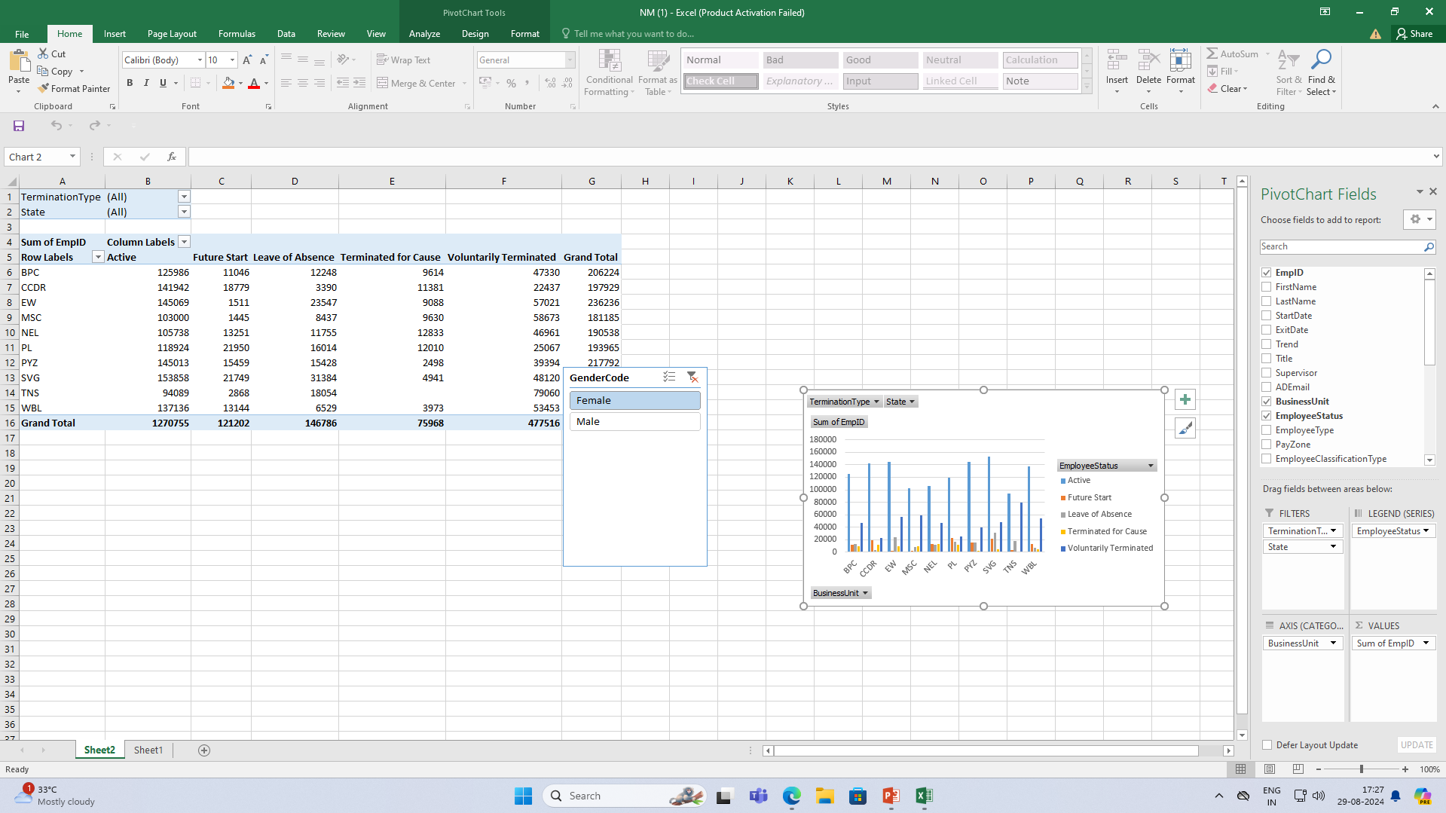
RESULTS
11

Slide 12
conclusion
*Using pivot tables for employee turnover analysis offers a powerful yet accessible way to derive meaningful insights from your workforce data.
*Pivot tables allow you to quickly and efficiently summarize, sort, filter, and analyze employee data by various dimensions such as department, job role, tenure, demographics, and reasons for leaving.
* This flexibility helps identify patterns and trends that can inform strategic decisions, such as targeted retention strategies, identifying departments or roles with high turnover, and understanding the underlying reasons for employee departures.

